Slide 1

CS/MR Digital Platforms 2022/23
Co-design Group Project
Doodle Jump
Authors:
Kirill Borodin
Svyatoslav Gubin
German Ritter

Slide 2
Original Game
Doodle Jump v 3.11.20 for Android
The game was created for iOS on 6 April 2009 by Igor and Mark Puseniaki and was ported to Android and Blackberry devices on 2 March 10.
The player must climb as high as possible using the various boosters. Enemies encountered along the way can be disposed of by shooting them.

Slide 3
Our Realization
For hardware we used “Logisim”: Classic;
Single core: CdM-8 mark5 full;
For the core, Harvard Architecture was chosen;
32x24 playing field created with 32 24-bit strings;
There are 3 buttons, 2 of which are used to move your character left or right, while the third is used to start the game or restart it;
The edges of the screen are stitched together and the character can move over one side to the other.

Slide 4
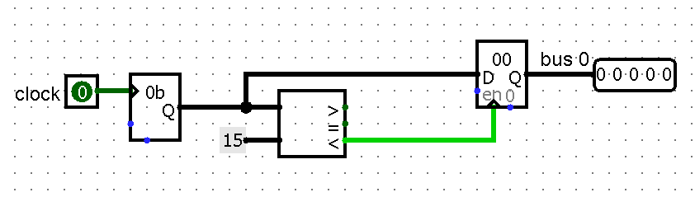
Hardware
getRandom
Chip for the random generation of the 5 bit string that define platform position in the field generation chip

Slide 5
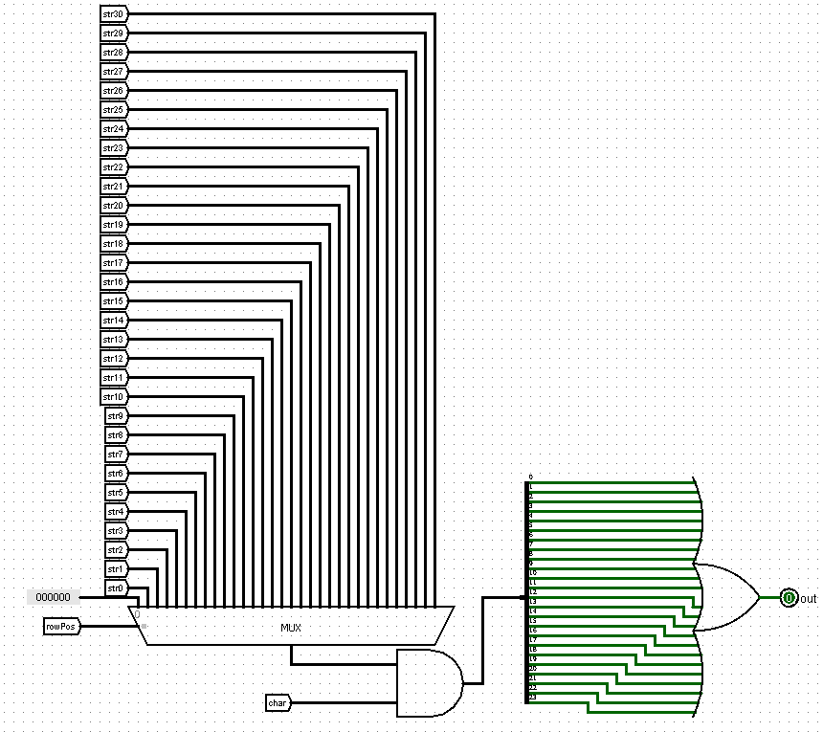
checkCollision
Choose the platform under the character and determine their collision

Slide 6
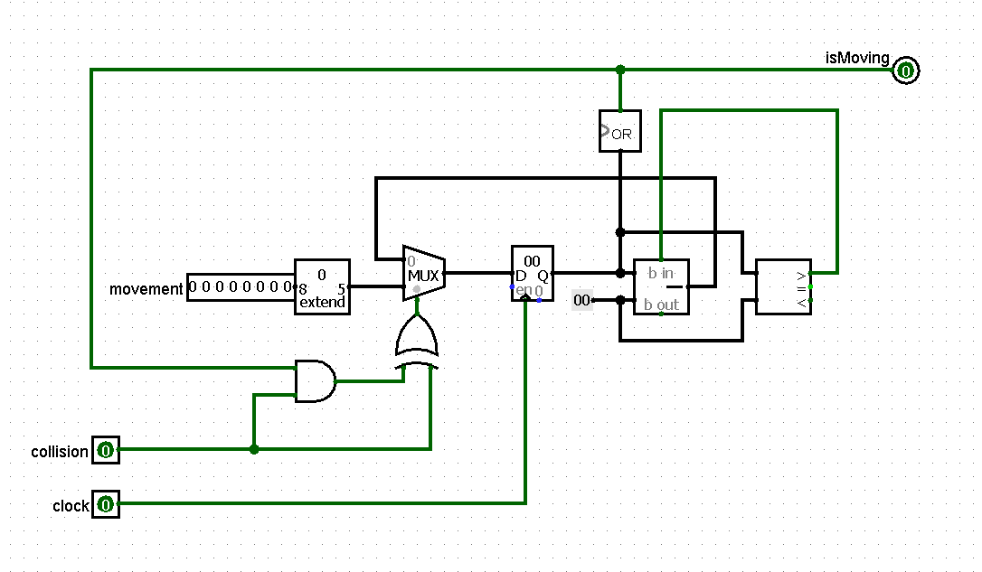
isMoving
Chip to get the state of the character's movement by a certain vector

Slide 7
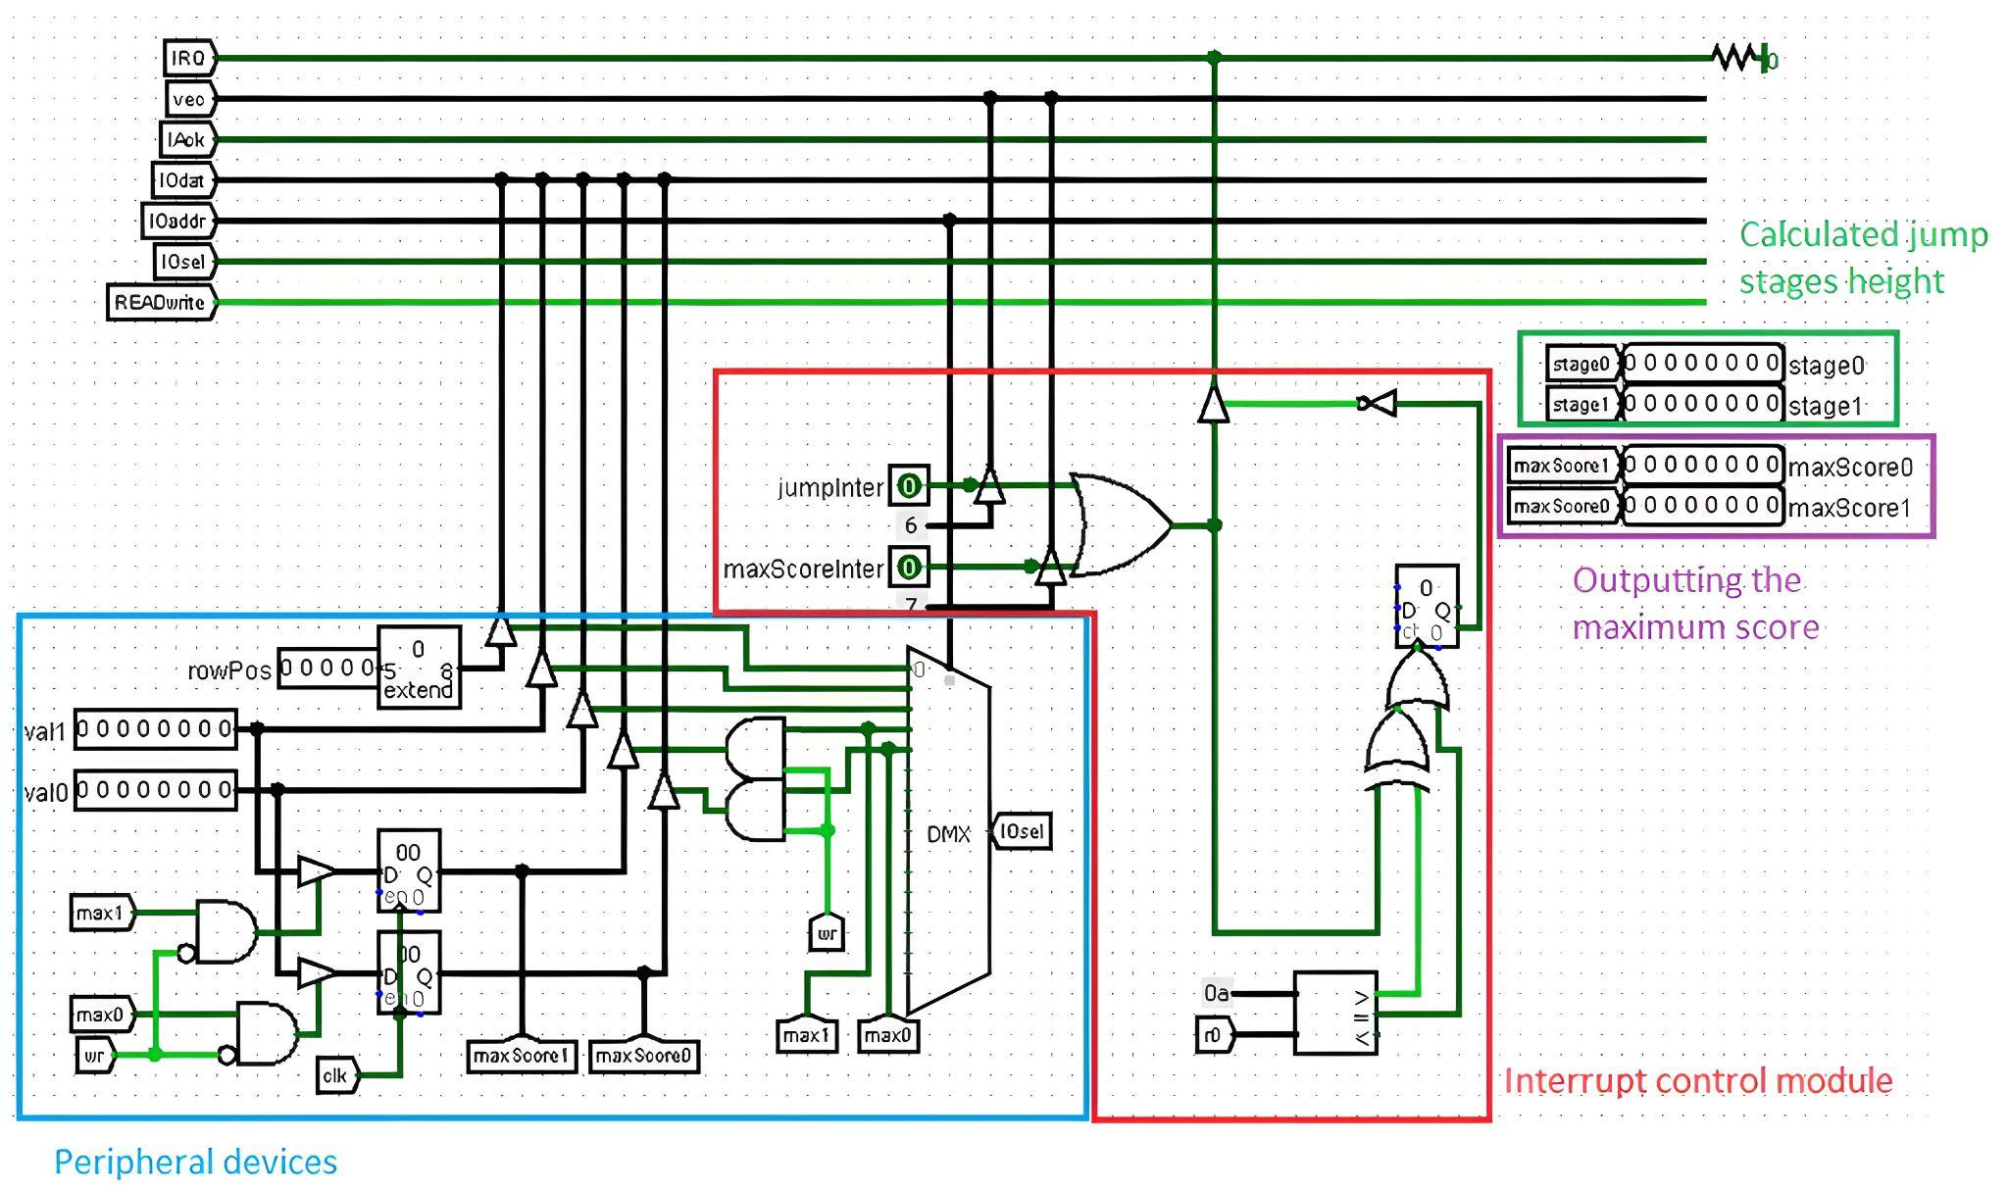
connectionWithProcessor
Detects interrupts and moves the PC register to a direct part of the program according to a specific vector
Receives the final attempt score and character position as input. Depending on the interruption, interacts with one of the inputs, either changing the score or changing the jump stage

Slide 8
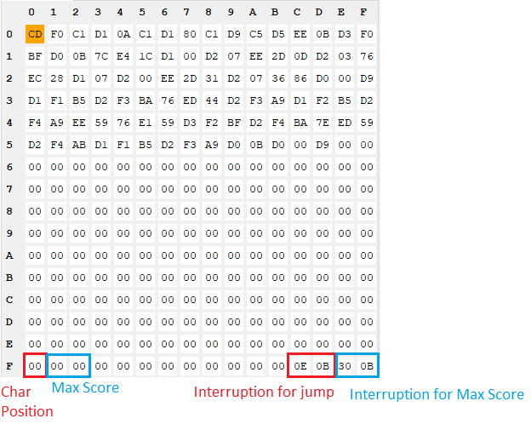
Software
GameLogic
Logical part of the jump, which consists of 2 stages to keep the character within a certain area of the screen to prevent him from constantly shifting to the bottom of the display.
Programm
Calculates the movement in each stage of the jump and maintains the location of the lower edge of the character no higher than the 12th line of the display.
When a character dies, an interrupt is triggered on the processor which updates the value in the max score field if the player has reached a higher position than in previous attempts.

Slide 9

Problems
Optimization of drawing character on the game field;
Using color of error as third;
Can’t realise moving platforms;
Using interruptions.

Slide 10


The END
Thank you for attention

